Slide 1

The Generative AI Revolution: A Month-Long AI Exploration
Week 1 Day 1: 2nd Mar 2024

Slide 2

π
Topics
Impact of GenAI across different Industry
Task performed by GenAI and Impact
Opportunity created by AI
Gen AI Can be used in many applications
Life Cycle of Generative AI application
Methods to enhance Generative AI Applications
Limitations

Slide 3
π
“AI is impacting various industries by automating the entire job or part of job.”

Slide 4
π
Impact of GenAI across Industry
01
Technology [$240 - 460B]
Software development and testing
Cybersecurity
Web Development and design etc.
02
Retail [$240 - 390B]
Customer experience and service
Marketing and sales
Supply chain and inventory management etc.
03
Banking [$200 - 340B]
Customer service [Chabot and virtual assistant]
Risk management and compliance
Credit score and lending
04
Healthcare
Diagnostic and imaging
Drug discovery and development
Patient care and monitoring
05
Education
Personalized learning
Curriculum development
Education administration
Source: McKinsey Report

Slide 5
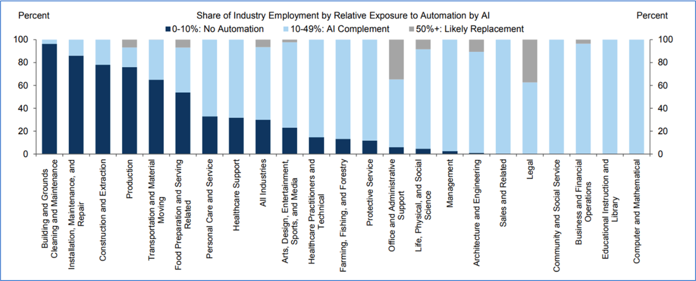
π
Impact of GenAI across Function
Source: Goldman Sachs Report

Slide 6
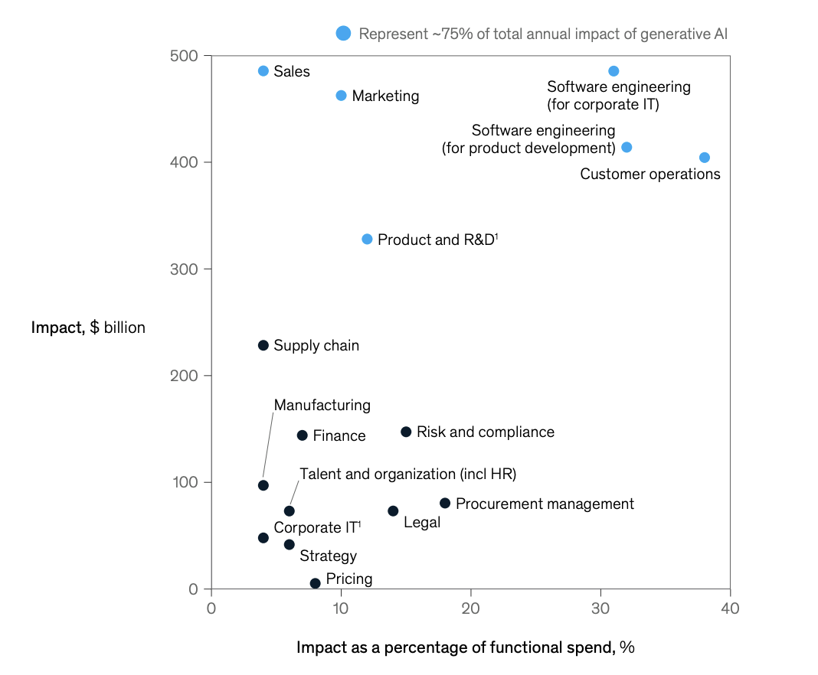
π
Impact of GenAI across Function
Source: McKinsey Report

Slide 7

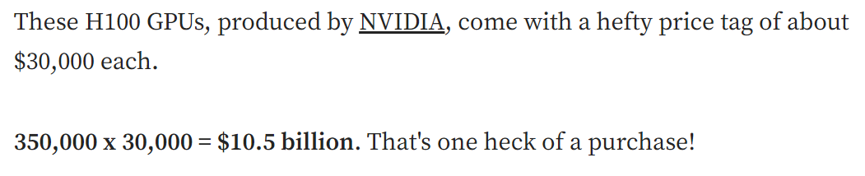
π
Latest News
https://generativeai.pub/mark-zuckerberg-is-buying-350-000-h100-gpus-for-its-ai-plans-fd89664fe245

Slide 8
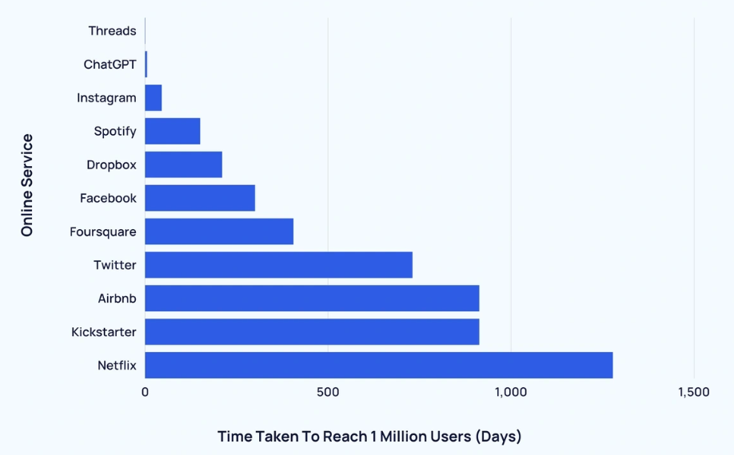
π
Time taken to reach 1 million users
https://explodingtopics.com/blog/chatgpt-users

Slide 9
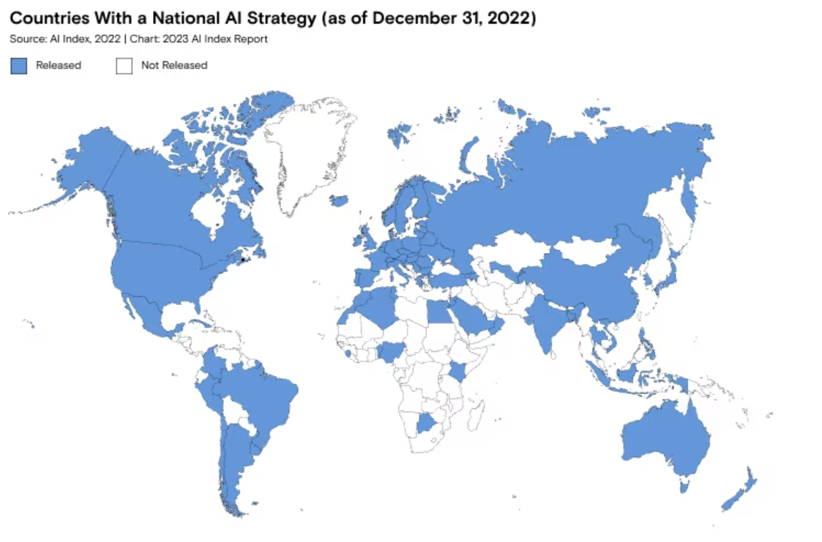
Countries With a National Strategy
π
https://openai.com/customer-stories/morgan-stanley

Slide 10










π
Possibilities with Generative AI.
Text Generation
Q&A
Text Summarization
Text Extraction
Paraphrase rephrase
Search
Code Generation
Image Generation
Image Classification
Audio Generation
Video Generation
Notes:
Create same if icon available

Slide 11
π
Task Performed by Generative AI
Generation / Rephrase (Image, Audio, Video, Text)
Translation
Summarization
Search or Extraction
Classification or Tagging
Notes:
- Generation (image / video / Text)
- Mr india news and its reference

Slide 12


π
Task: Translation
Translate a piece of content from one language to another language. This could be text or audio.

Slide 13
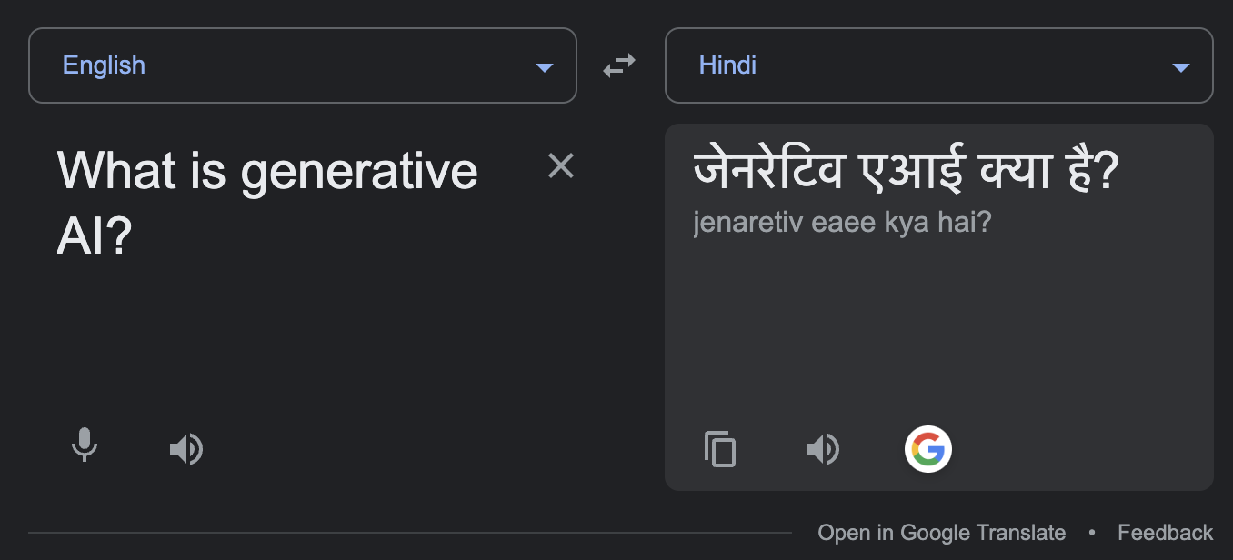
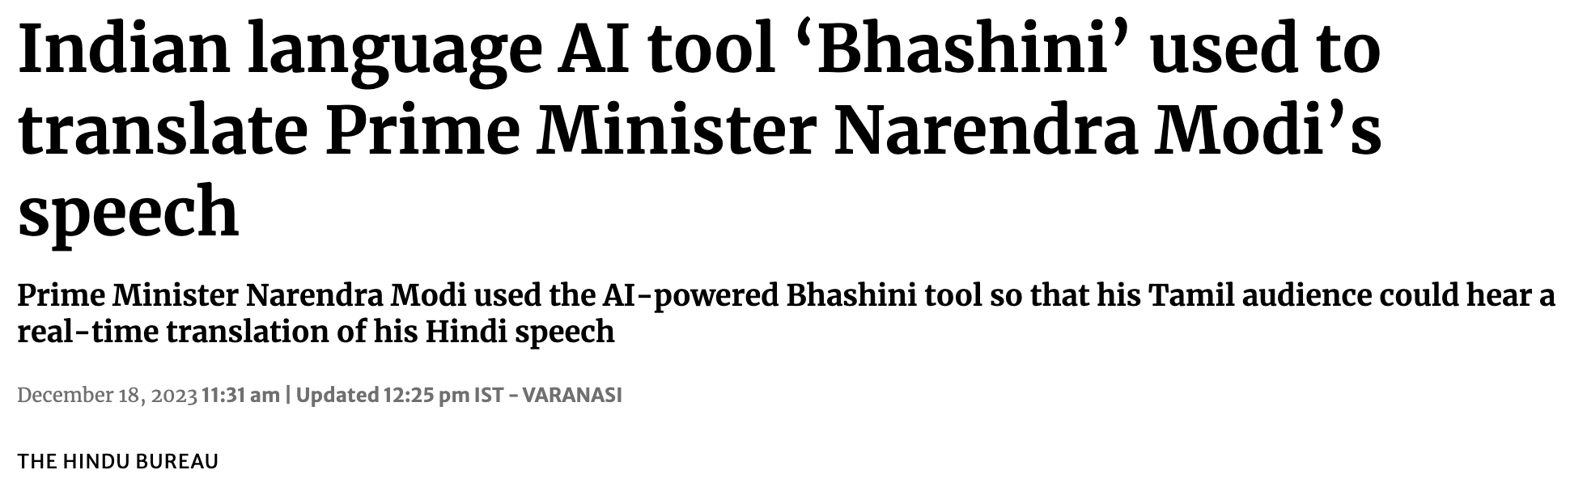
π
Translation: Example

Slide 14
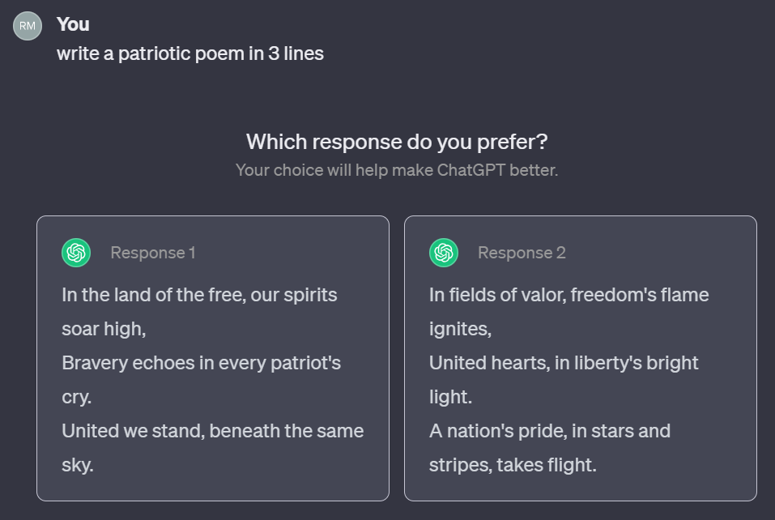
Gen AI Writing Example
π
Writing
Prompt: Is delivery service offered at your showroom?
Response: Certainly, you have the option to select fast delivery. With this option, we guarantee delivery on the same day.

Slide 15
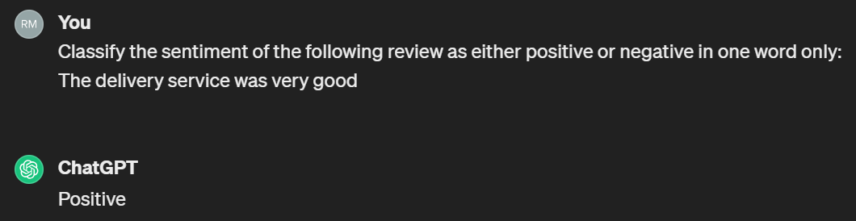
Gen AI Reading Example
π
Reading
Prompt: Classify the sentiment of the following review as either positive or negative:
The delivery service was very good
Response <as shown in the screenshots>

Slide 16
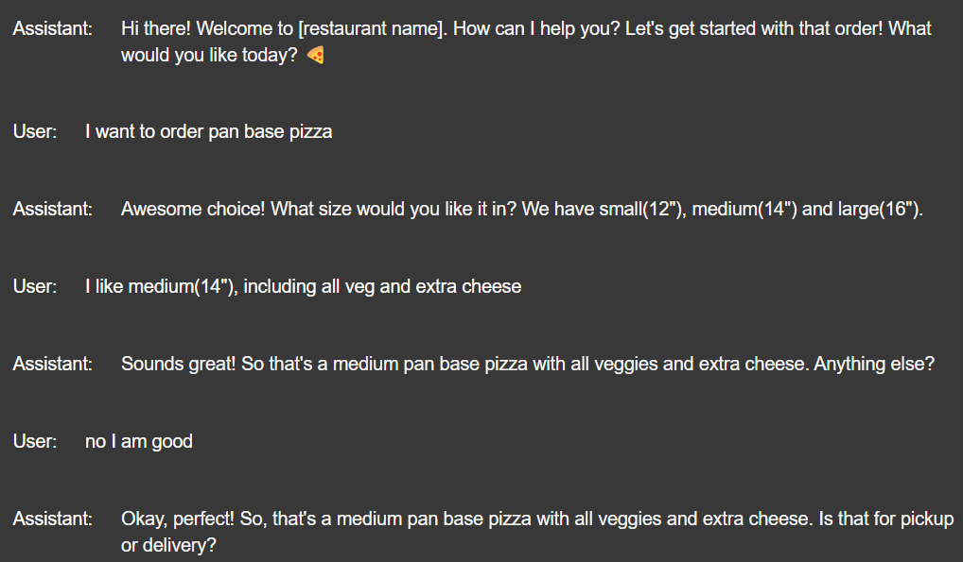
Gen AI Chatting Example
π
Chatting
Bot: Welcome to the showroom!
User: I am looking for a laptop
Bot: Win. Mac. or Linux ?
User: Windows
Bot: i3, i5, i7
User: i7
Notes:
Remove this screen shot and add food order app screen shot

Slide 17
What Is Prompt Engineering ?
π
Syntax hacking
Prompt-tuning
Single-shot
Getting a perfect answer from the model on your first try
Spectrum Of Prompting Technique
Testing every combination until it works
Prompt Templates
Zero-shot
Few-shot
Notes:
Create same if icon available

Slide 18
Understanding the Rising Popularity of Gen AI
π
Get labelled data
Train AI model on data
Deploy (run) model
Machine learning
1 month
3 months
3 months
Specify prompt
Deploy (run) model
Generative AI
minutes/hours
hours/days
Notes:
Rephrase text of this slide

Slide 19

Lifecycle of Generative project
π
Scope Project
Build/Improve System
Internal Evaluation
Deploy and Monitor
Take Laptop order
User: How much RAM does the Windows laptop have?
Bot: I’m sorry, I don’t know

Slide 20
Lifecycle of Generative project
π
Scope Project
Build/Improve System
Internal Evaluation
Deploy & Monitor
Take Laptop order
User: How much RAM does the Windows laptop have?
Bot: About 4 to 32 GB

Slide 21
Ways To Customize Base LLM
π
Pretraining
Fine Tuning*
Accuracy
Retrieval Augmented Generation
Prompt Engineering
Complexity & Cost
Notes:
REDO and notes prepare for presentation

Slide 22
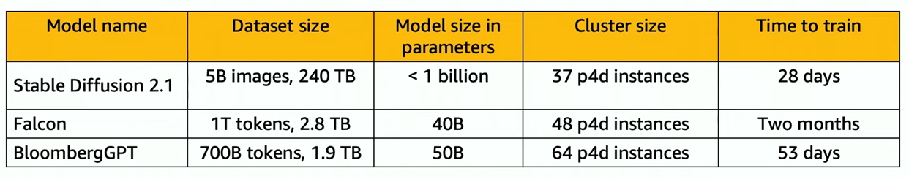
Pretrain process Requires
π
source: https://www.youtube.com/watch?v=0xfe54_pYIQ&list=PLhr1KZpdzukf-xb0lmiU3G89GJXaDbAIF&index=6
Notes:
REDO and notes prepare for presentation

Slide 23
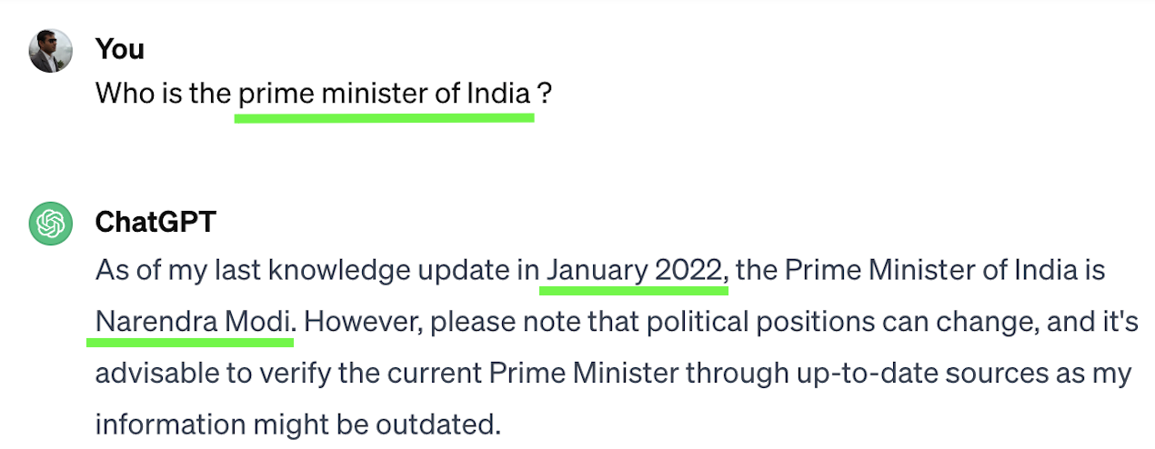
π
Limitations of Gen AI: Knowledge Cutoff
Knowledge Cutoff: An LLM’s knowledge of the world is frozen at the time of its training

Slide 24

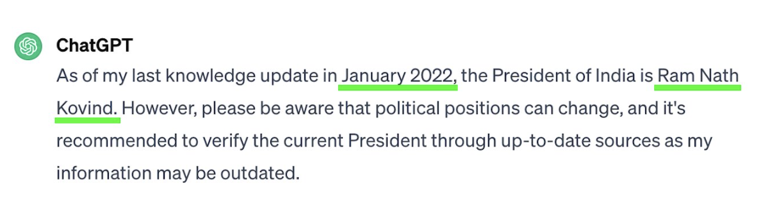
π
Limitations of Gen AI: Knowledge Cutoff

Slide 25

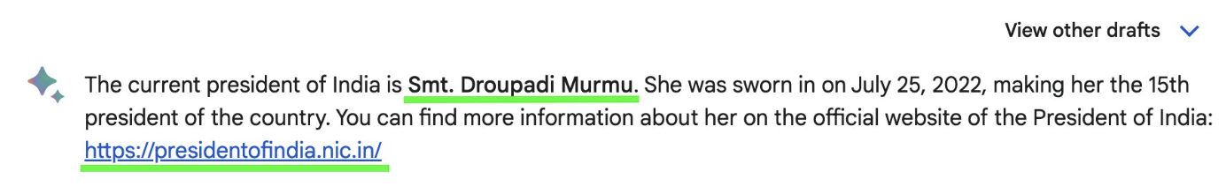
π
Limitations of Gen AI: Knowledge Cutoff

Slide 26
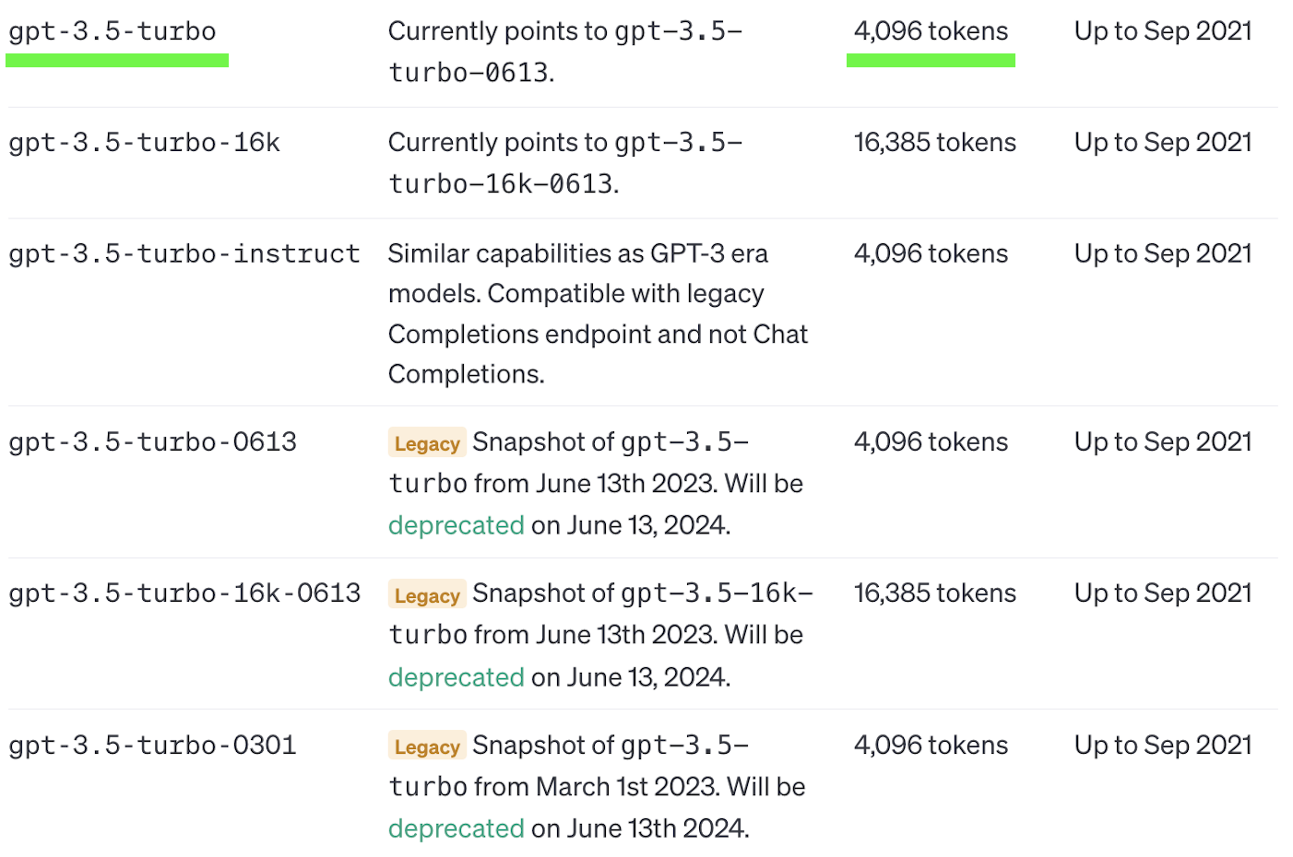
π
Limitations of Gen AI: Token Limits
Source: https://platform.openai.com/docs/models/gpt-3-5

Slide 27
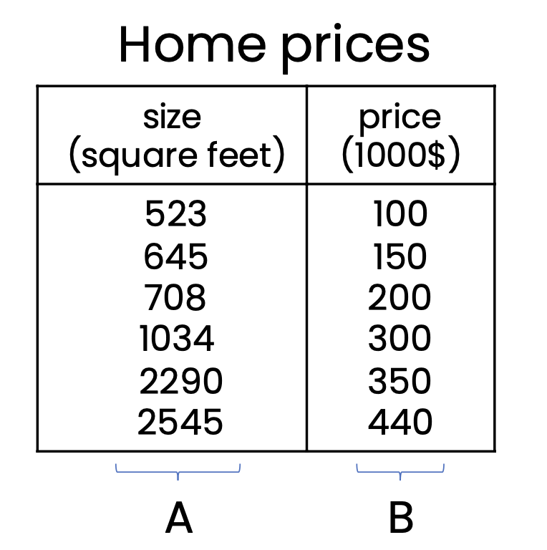
π
Limitations of Gen AI: Tabular Data
Gen AI does not work well with structured (Tabular) data.
Supervised Machine Learning is best for tabular datasets

Slide 28



π
Communications Channels
https://whatsapp.com/channel/0029VaOManvEKyZMoPCtPU24
Discord: https://discord.gg/r4pNVqcpCr
Linkedin: https://www.linkedin.com/company/edquestofficial/

Slide 29
π
Thank You!

